Slide 1
EY Data Challenge: Urban Heat Islands
Benjamin Nicholson and Jonah Zembower

Slide 2
EY Data Challenge: Urban Heat Islands
What? The EY Data Challenge has been operating since 2020 and is focused on the application of machine learning and statistical analysis to solve earth science problems
When? January 20 2025 - March 20 2025
Who? Applicants from all over the world (currently at 1200+ registrations)
Why? Guided experience through using satellite imagery APIs and implementing machine learning into the creation of a regression model

Slide 3
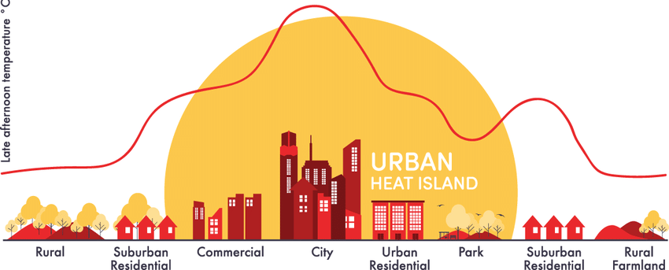
Urban Heat Islands Background Information

Slide 4
The Challenge
Temperature data has been recorded at different locations across Manhattan and the Bronx in New York City
This is used to formulate the Urban Heat Index (UHI)
Goal: Predict the UHI for a given location.

Slide 5
Data Available
Training UHI Index Data
Includes the longitude and latitude with respective UHI there
Bronx and Manhattan data collected for air temperature and other variables
Satellites
European Sentinel-2 Optical Satellite
NASA Landsat Optical Satellite
Open Sourced New York Data
Includes building height, roads, distance to shoreline, wind tunnels, tree canopy

Slide 6
EDA
Looked at the correlation of the features.
Showcased Data Collected:
UHI Index
Air Temp at Surface [deg C]
Relative Humidity [percent]
Avg Wind Speed [m/s]
Wind Direction [deg]
Solar Flux [W/m²]
Planetary Computer Data:
Surface Temperature
Median Composites
NDVI
NDBI
NDWI
Open Source New York Data

Slide 7
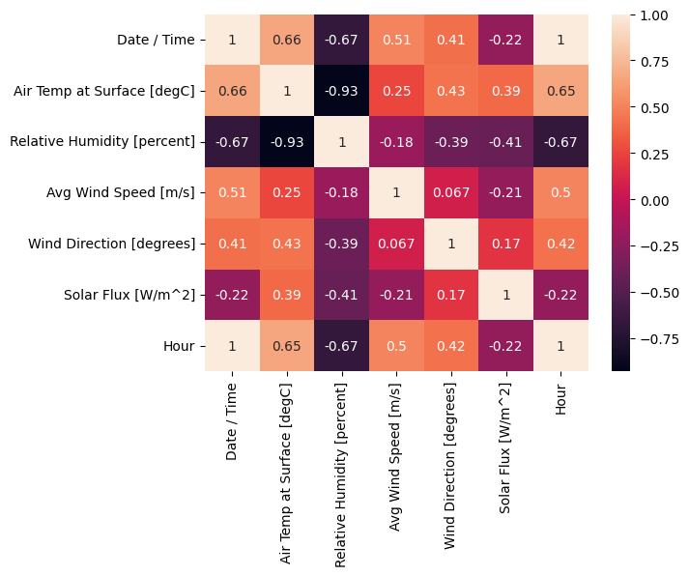
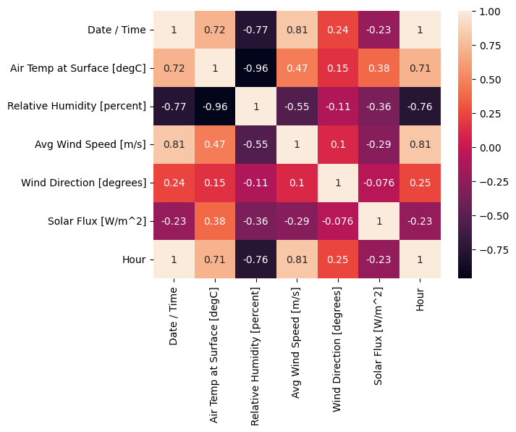
Correlation of Base Features
Manhattan Data
Bronx Data

Slide 8
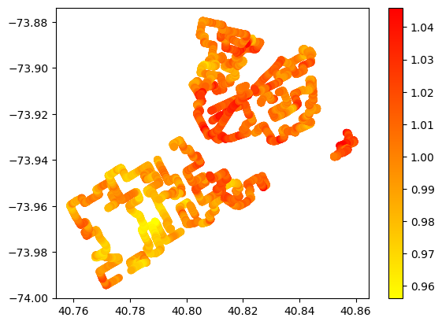
Training UHI Index Values
Includes longitude and latitude values
UHI index at each point

Slide 9
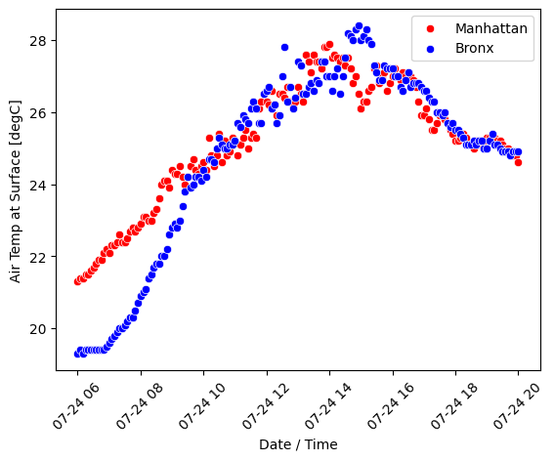
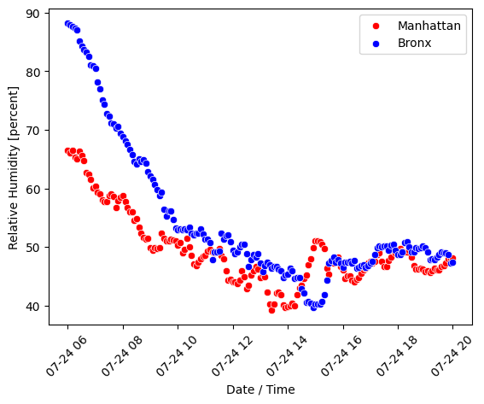
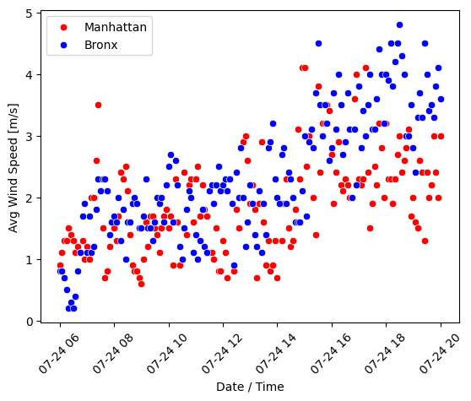
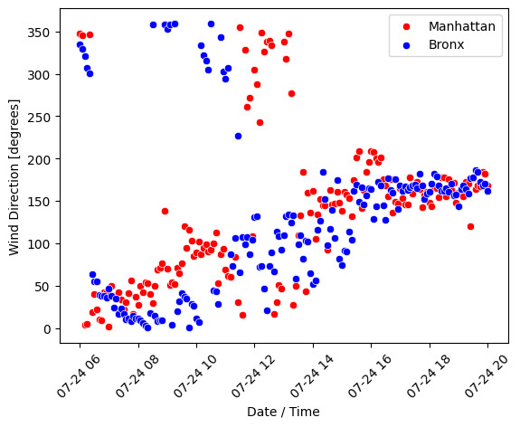
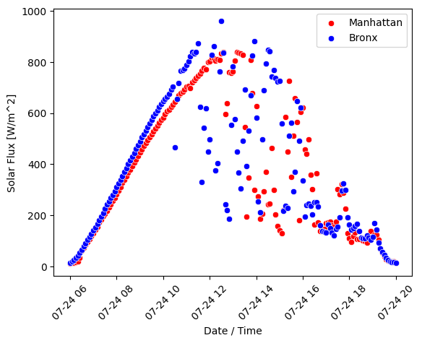
Manhattan Versus Bronx
Air Temp at Surface [deg]
Relative Humidity [percent]
Avg Wind Speed [m/s]
Wind Direction [degrees]
Solar Flux [W/m²]

Slide 10
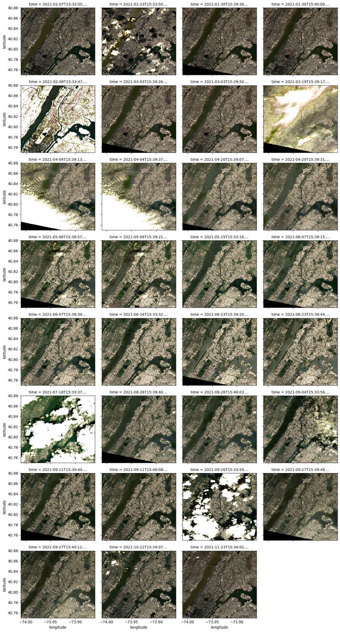
Planetary Computer Scenes
Images related to longitude and latitude selected from landsat satellite
There were a total of 31 scenes of pictures in 2021

Slide 11
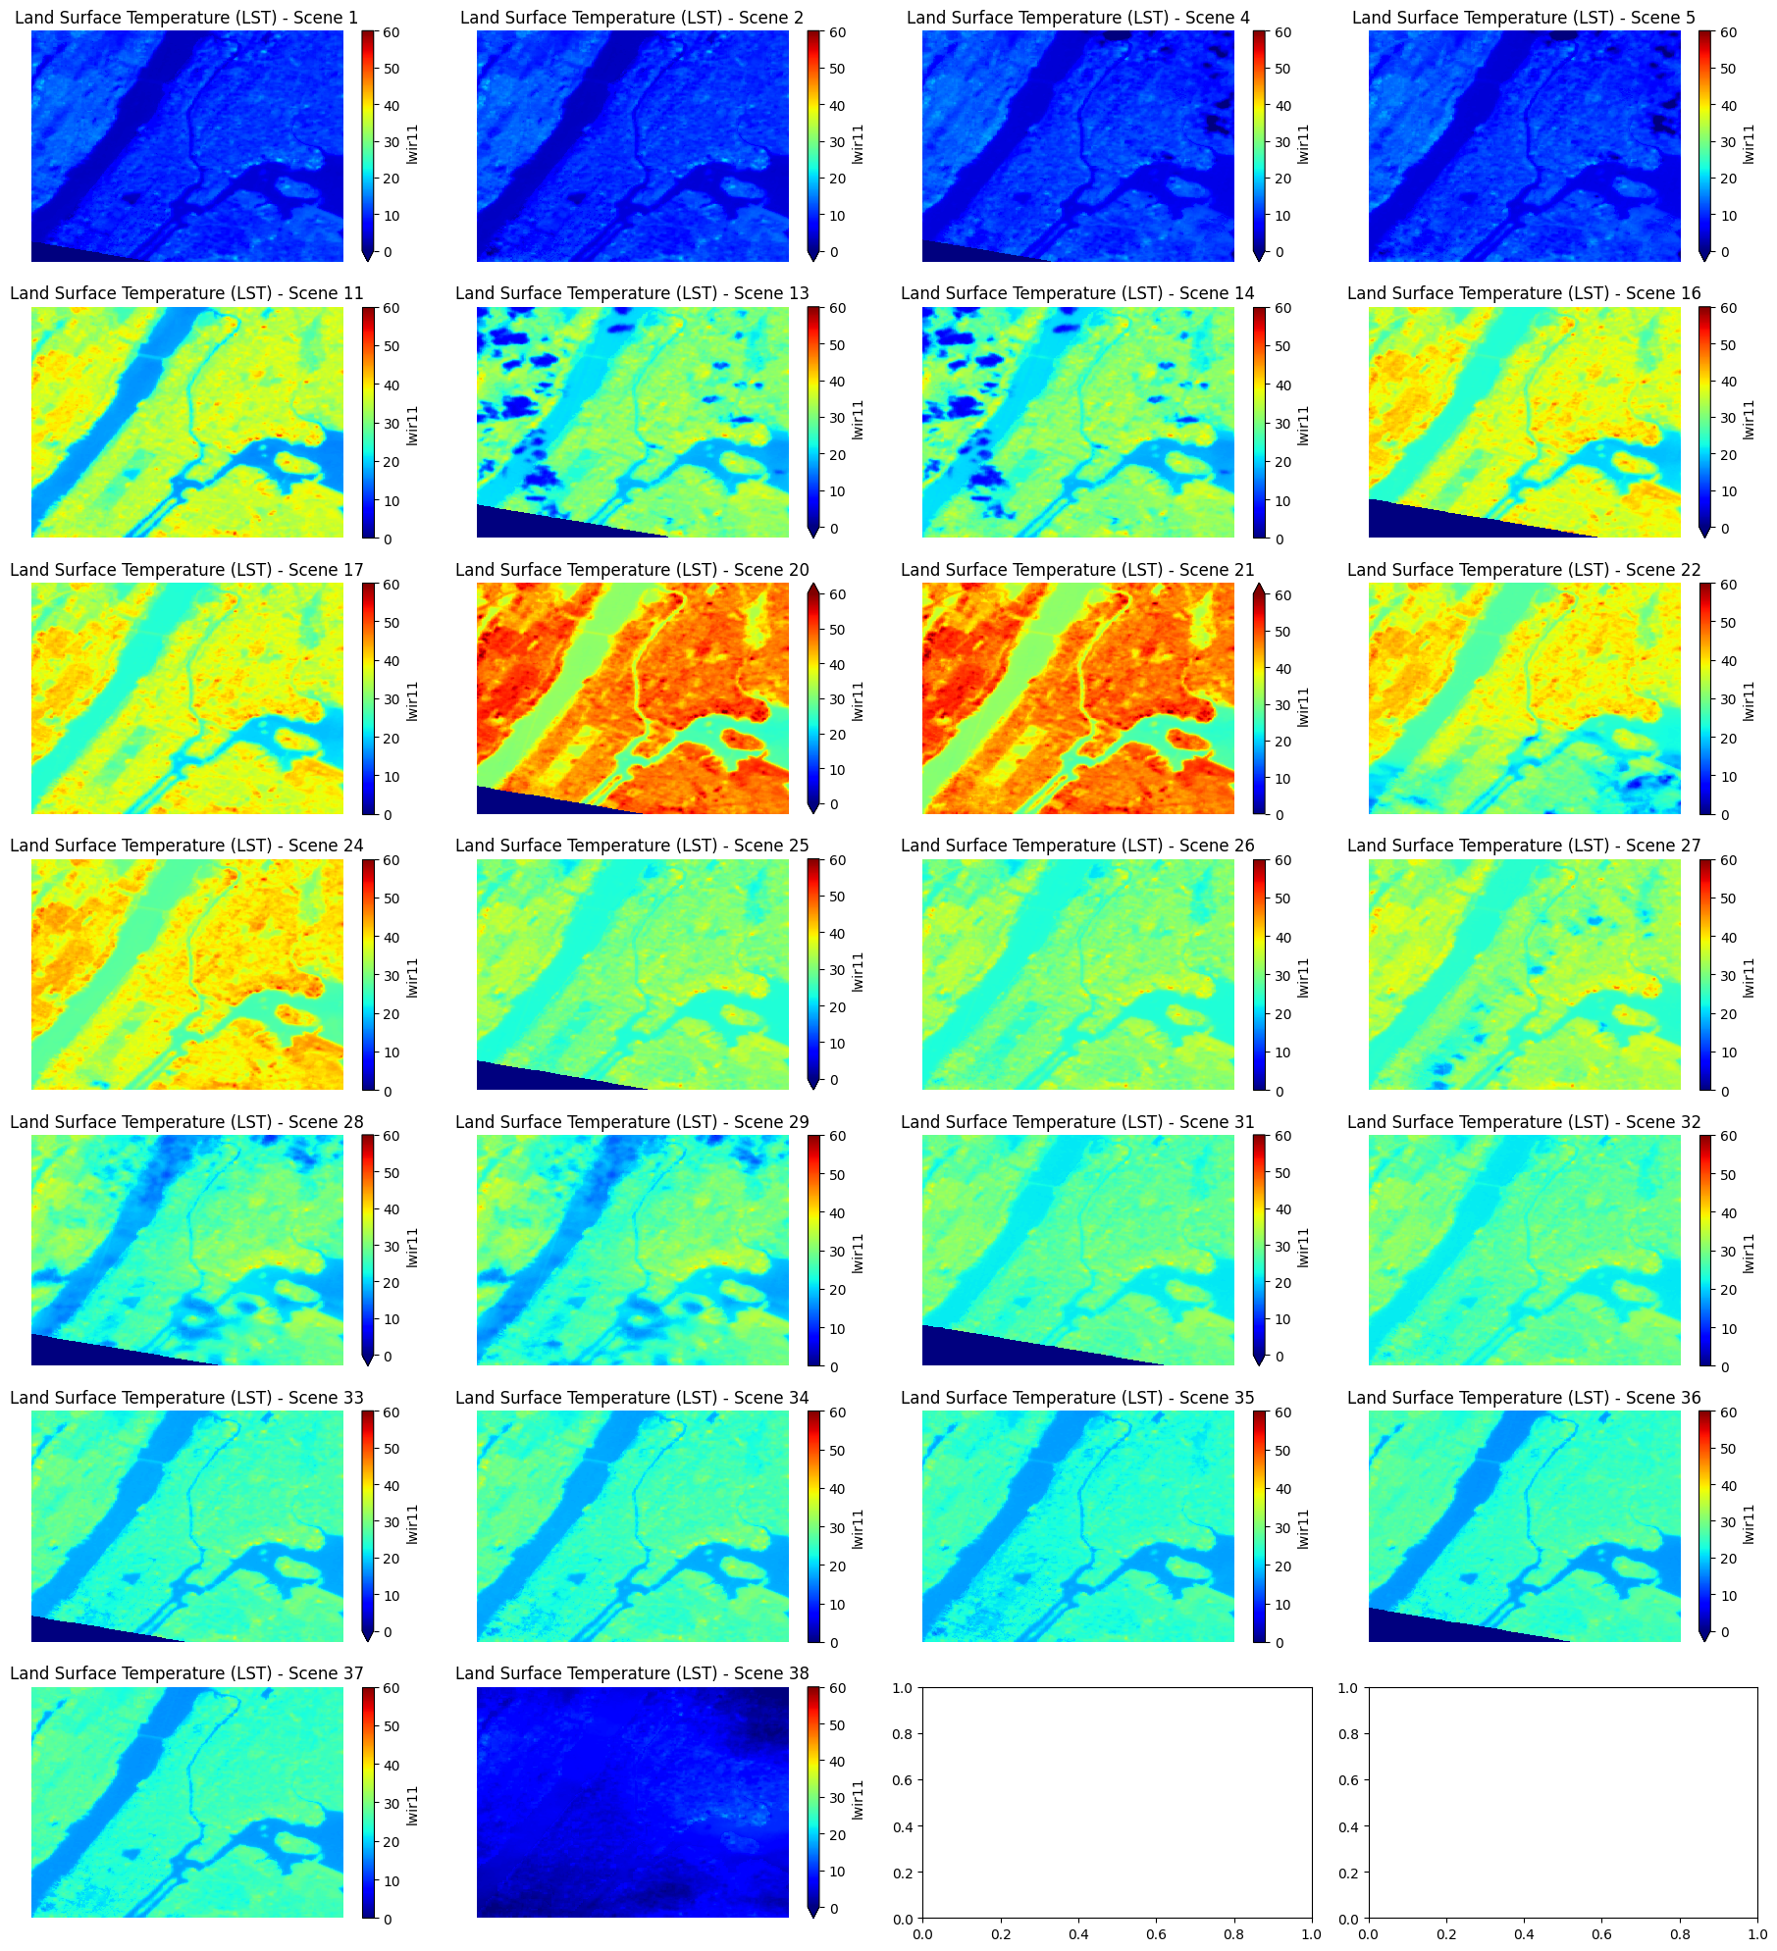
Planetary Computer Land Surface Temperature
Land surface temperature related to the detected surface temperature in 2024
This was found using the Landsat Satellite

Slide 12
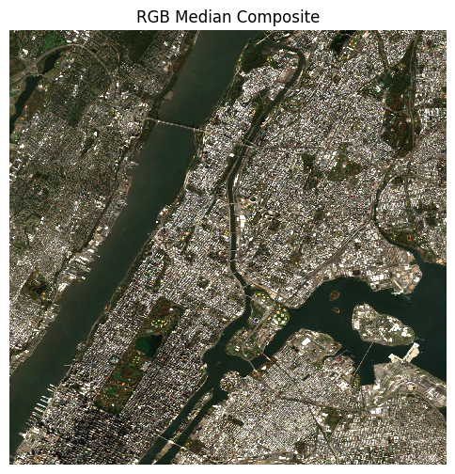
Planetary Median Composite
Using normal xarray operations, we can compute the median pixel value at that point over many images.
This chooses a best image across multiple captures in a given year or timeframe.

Slide 13
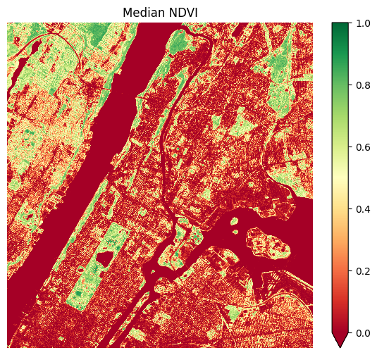
Planetary Computer NDVI
The NDVI is a calculated value describing the vegetation index gradient.
Higher values indicate more vegetation.
This is found using certain bands from the Sentinel-2 Satellite.

Slide 14
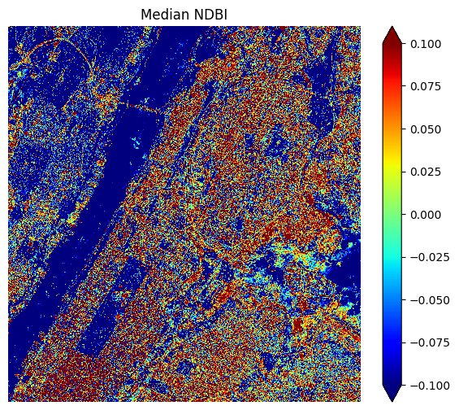
Planetary Computer NDBI
The NDBI is calculated as a gradient ratio for the certain bands from the Sentinel-2 Satellite.
Showcases higher values reflecting more urbanization.

Slide 15
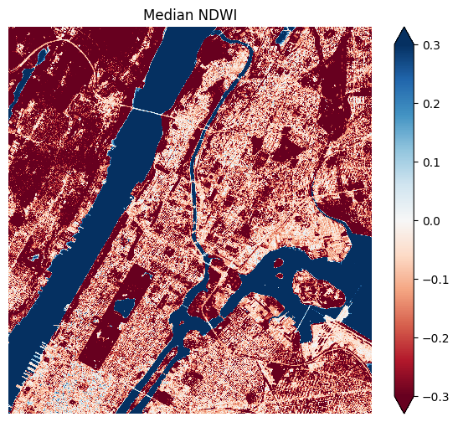
Planetary Computer NDWI
The NDWI is a calculated ratio using the Sentinel-2 Satellite bands.
This highlights areas of water in blue and areas with little water in more red.

